Slide 1

Exploring User Behavior in UI/UX Across Digital Platforms
Sara Allali

Slide 2

Agenda
Project Goals
Dataset Overview
Key Insight 1: Accessibility
Key Insight 2: Engagement Features
Key Insight 3: Platform Differences
Key Insight 4: UX Improvement Opportunities
Conclusion

Slide 3


Challenges
and Objectives
Understand how different UI/UX elements impact overall user experience
Identify which design components contribute to positive vs negative interactions
Use data-driven insights to recommend improvements in user-centered design

Slide 4

Data Overview
Dataset of 2,271 users analyzing UI/UX preferences and experiences
Includes:
Demographics (age, gender)
Platform usage (e.g., Instagram, YouTube, Website)
Ratings (1–5) for UI/UX components (layout, accessibility, loading speed, etc.)
User experience categorized into Positive, Neutral, and Negative for analysis

Slide 5

Insight 1 — Accessibility Issues
Insight | What this means | Recommendation
Accessibility showed the strongest negative difference between positive and negative user experiences | Poor accessibility is a major driver of user frustration | Poor accessibility is a major driver of user frustration

Slide 6
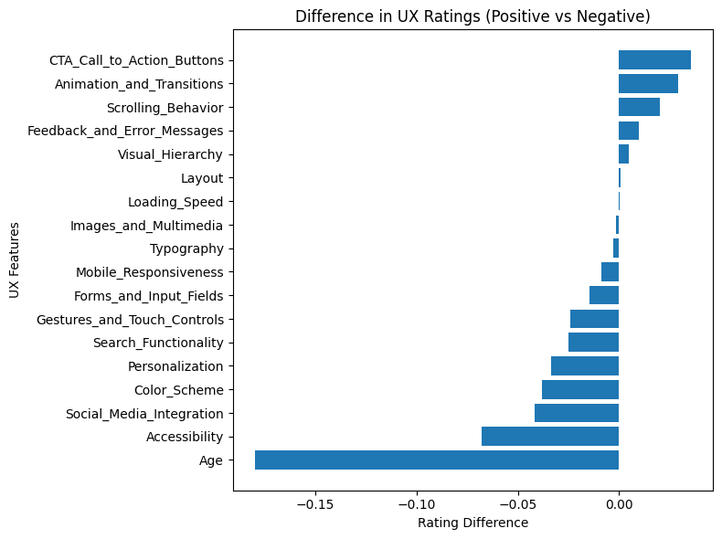
Insight 2 — Engagement Features Drive Positive UX
Insight | What this means | Recommendation
Features like call-to-action buttons, animations, and scrolling behavior are associated with more positive experiences | Interactive and engaging elements enhance usability and satisfaction | Optimize CTA visibility and clarity Use animations intentionally to guide user interaction Maintain smooth and intuitive scrolling experiences

Slide 7

Insight 3 — Platform Differences in UX
Insight | What this means | Recommendation
Platforms like YouTube and Facebook show higher positive experiences, while others show relatively higher negative rates | UX effectiveness varies across platforms | Analyze platform-specific design patterns Apply best practices from higher-performing platforms Tailor UX improvements based on platform behavior

Slide 8
Conclusion
The majority of users reported positive experiences, but a significant portion faced usability challenges
Key issues such as accessibility, visual design, and personalization contribute to negative user experiences
Features like CTA buttons, animations, and smooth interactions are associated with more positive engagement
User experience is shaped by a combination of multiple design elements rather than a single factor
Data-driven insights can guide meaningful improvements in user-centered design
Improving UX requires a balanced approach that prioritizes usability, accessibility, and engagement.

